Slide 1
Commutative, Distributive and Estimative Justice in Adam Smith
By Daniel Klein, Econ & Mercatus, GMU, & Ratio Institute
To appear in Adam Smith Review

Slide 2
Commutative justice
“The most sacred laws of justice, therefore, those whose violation seems to call loudest for vengeance and punishment, are the laws which guard the life and person of our neighbour; the next are those which guard his property and possessions; and last of all come those which guard what are called his personal rights, or what is due to him from the promises of others.” (84.2)
(Elsewhere Smith includes reputation.)

Slide 3
“commutative”?
Commuter: point-to-point
Commutative: part-to-part
As opposed to:
part-to-whole
whole-to-part
whole-to-whole

Slide 4
Doctrine 1
Doctrine 1:
Justice is simply CJ.
Confine your justice talk to CJ.

Slide 5
Double doctrine
Doctrine 1: Justice is simply CJ; confine justice talk to CJ.
Doctrine 2: Justice is not simply CJ; talk justice beyond CJ.
Smith gives an impression of affirming Doctrine 1, but really he affirms Doctrine 2.

Slide 6
Evidence of Doctrine 2
Smith AFFIRMS the three senses of justice.

Slide 7
The Justices Paragraph
graf 269-270.10:
commutative justice – CJ
distributive justice – DJ
estimative justice – EJ

Slide 8
Evidence of Doctrine 2
Smith AFFIRMS the three senses of justice.
Smith pervasively talks justice beyond-CJ.

Slide 9
36 cases of DJ

Slide 10
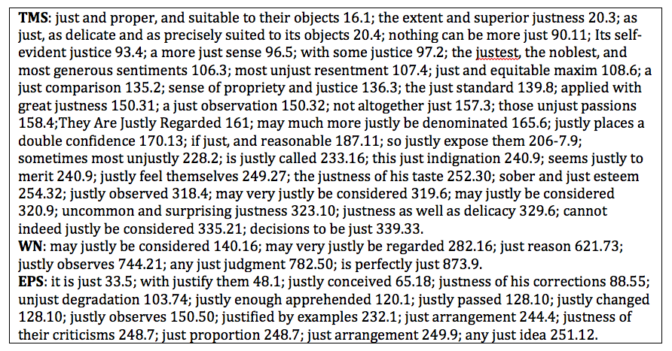
57 cases of EJ (in E-E)

Slide 11
12 cases of EJ (in S-i)

Slide 12
105: That’s a lot!
36
57
+ 12
105

Slide 13
justice and its cognates:
TMS:
382 occurrences: More than 50% are beyond-CJ
WN:
193 occurrences: More than 15% are beyond-CJ

Slide 14
Question:
Why would Smith generate a double doctrine on justice?

Slide 15
Contrarieties in Hume and/or Smith
Justice
Reason
Nature, natural
Impartial spectator
Liberty, freedom

Slide 16
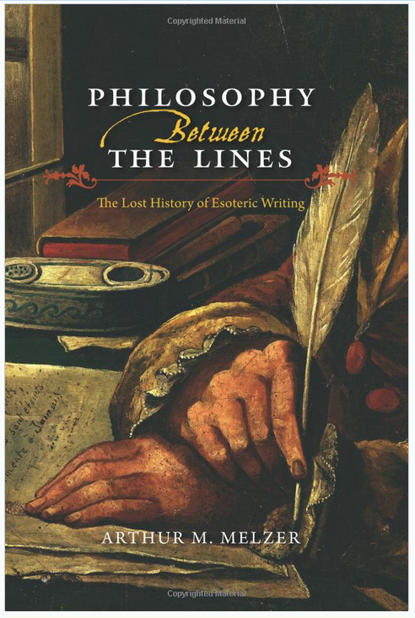

Slide 17
Should you go beyond CJ?
Options:
One sense of justice: just CJ
Two senses of justice: CJ and ZJ
Three senses of justice: CJ, DJ and EJ

Slide 18
Adam Smith
Commutative justice:
Not messing with
other people’s
stuff
Understood within historical context.
Uniformity amidst variety.
Government law affects fine points but does not undo natural conventions
Notes:
…
General formulation but…
Uniformity amidst diversity.
Government law affects fine points but does not undo natural conventions

Slide 19
Roadmap, scheme
The Justices Table -- handout

Slide 20
Commutative justice
Not messing with
other people’s
stuff
CJ is special among the virtues
CJ plays special roles within TMS
Notes:
CJ is special among the virtues.
CJ plays special roles within TMS.

Slide 21
The Jural Superior
The Superior paragraph (81.8):
“A superior”
“The laws”
“The civil magistrate”
“the sovereign”
“a law-giver”

Slide 22
Two jural relationships
the Equal-Equal relationship (E-E)
the Superior-inferior relationship (S-i)
Notes:
One of the special roles is to distinguish two sorts of jural relationships…

Slide 23
Specialness of CJ
Unlike the rules of all the other virtues, the rules of CJ are “precise and accurate.”
→ “perfect” right
The actions it treats are ones we are not to do; doing nothing (passiveness) is often sufficient to fulfilling CJ.
Feedback on one’s performance of CJ is only negative (or neutral).
Notes:
Smith emphasized the specialness of CJ…

Slide 24
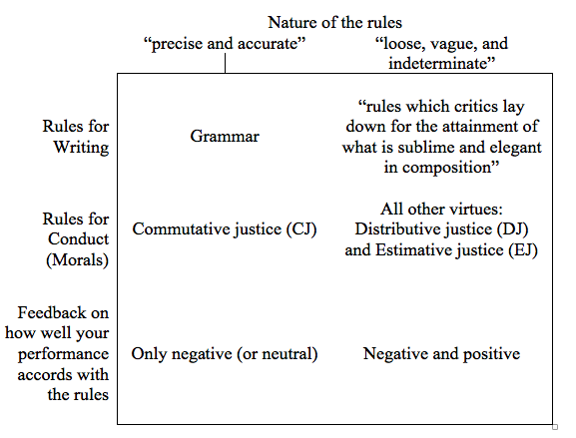
Parallel of rules

Slide 25
Aesthetics vs. grammar

Slide 26
Specialness of CJ
In E-E, an observance of the rules of CJ is “indispensable” -- otherwise society degenerates.
In E-E, we feel a stricter obligation to observe CJ than other virtues; indeed, CJ may be forced.

Slide 27
Specialness of CJ
The formulation of CJ admits of a flipside: Others not messing with your stuff
In E-E: “security”
In S-i: “liberty,” “natural liberty.”
“Both laws were evident violations of natural liberty, and therefore unjust” (WN, 530.16)

Slide 28
Distributive justice
“the becoming use of what is our own”
“proper beneficence”
DJ is done to persons.

Slide 29
Distributive justice
“…all of whom thus derive from his luxury and caprice, that share of the necessaries of life, which they would in vain have expected from his humanity or his justice.” (184.10)

Slide 30
Estimative justice
Estimating objects properly
External objects
Internal objects
➔ recursivity, the deepself

Slide 31
EJ is only as grand as the object estimated
The proposed Constitution
Presumption of liberty
Klein’s interpretation of justice
Klein’s chewing gum

Slide 32
Estimative justice
Conceptions of the good of larger wholes
Beliefs about how that good is served
Conceptions of the good of (one’s) smaller parts
Beliefs about how that good is served
Relations between the larger and smaller
Strategic discourse, esotericism, deceit
Self-deceit, groupthink, faction, fanaticism, “false notions of religion”
Path-dependence of the self

Slide 33
Knowledge problems

Slide 34
CJ in DJ in EJ

Slide 35
Govt actor as a sort of Equal
For example, an administrator of a government owned university.

Slide 36
The Jural Superior
I propose that the superior, qua superior, owns nothing.
Hence, DJ does not apply to S-i.
The justices that apply are only CJ and EJ.
Example: Law against selling your kidney.

Slide 37
“Just” maxims of taxation
“The evident justice and utility of the foregoing maxims [of taxation] have recommended them more or less to the attention of all nations” (WN, 827.7)
I say that “justice” is EJ, not DJ and not CJ.

Slide 38
CJ in DJ in EJ
“…and the pursuit of happiness”
“life, liberty,”

Slide 39
Another distinction
Calling loudly
versus
Proffering coolly

Slide 40
Commutative justice
“The most sacred laws of justice, therefore, those whose violation seems to call loudest for vengeance and punishment, are the laws which guard the life and person of our neighbour; the next are those which guard his property and possessions; and last of all come those which guard what are called his personal rights, or what is due to him from the promises of others.” (84.2)
(Elsewhere Smith includes reputation.)

Slide 41
Calling loudly
“To remove a man who has committed no misdemeanour from the parish where he chuses to reside, is an evident violation of natural liberty and justice.” (WN 157.59)
“To hinder, besides, the farmer from sending his goods at all times to the best market is evidently to sacrifice the ordinary laws of justice to an idea of public utility, to a sort of reasons of state …” (WN, 539.39)

Slide 42
Proffering coolly
In noting that ground-rent taxation will fall more heavily on the rich:
“It is not very unreasonable that the rich should contribute to the public expence, not only in proportion to their revenue, but something more than in that proportion.” (WN 842.6)
“Both laws were evident violations of natural liberty, and therefore unjust; and they were both too as impolitick as they were unjust.” (WN, 530.16)

Slide 43
Smith’s non-CJ justice talk is never calling loudly
“The expence of maintaining good roads and communications is, no doubt, beneficial to the whole society, and may, therefore, without any injustice, be defrayed by the general contribution of the whole society. … The expence of the institutions for education and religious instruction, is likewise, no doubt, beneficial to the whole society, and may, therefore, without injustice, be defrayed by the general contribution of the whole society.” (WN, 815.4,5)

Slide 44
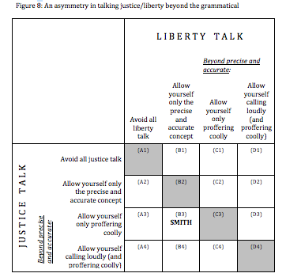

Slide 45
EJ cannot be assimilated to DJ
For EJ:
No clear stock of “esteem points”
No clear set of object over which one is to distribute esteem points
The logic of correlative rights and duties doesn’t work well. Does the picture have a right to estimated justly?

Slide 46
We need to jump from one to three
Options:
One sense of justice: just CJ
Two senses of justice: CJ and ZJ
Three senses of justice: CJ, DJ and EJ

Slide 47
The 3J theory and liberalism
All three justices are about an actor and his or her actions: Who is the actor? What is the action?
The 3J theory accentuates the specialness of CJ. It highlights CJ as a social grammar for E-E, and presumption of liberty as a focal point in politics.
DJ demands: Who is the actor? What is his stuff? To whom does he have duties?
EJ demands: Who is the actor? What is the object for estimation?
The 3J theory teaches that DJ and EJ are loose, vague, and indeterminate: We will disagree on the higher things.
The 3J theory tells us to proffer coolly on matters of DJ and EJ.

Slide 48
Conclusions
Smith affirmed and practiced justice talk beyond CJ
Nonetheless, CJ is very special
It plays special roles in his work
In numerous ways it is very special among the virtues
By and large, it alone ever warrants calling loudly
Its flipside, liberty, is central to Smith: Even in S-i, Smith maintains a presumption of liberty.

Slide 49
Punchline conclusion
Smith’s teachings and example guide us on how to talk justice beyond commutative:
Formulate it as either distributive or estimative—not an admixture of the two—and proffer it coolly.

Slide 50
Why the double doctrine?
He wanted us to see CJ as very special.
Pedagogical esotericism.

Slide 51
Thank you for your attention!

